Slide 1
After Capitalism: A Step Beyond Purpose
GM Global Trends Network
Andy Hines

Slide 2
Approach
Topic | Description | Time
Overview of After Capitalism | Discuss research, drivers, and resulting 3 images of future | 30 mins
Potential Issues for GM today | Poll question: audiences picks their top 3 of 9 issues | 10 mins
Responses to top poll questions | Presenter thoughts and audience reaction to top 3 issues | 15 mins
Wrap | Places to intervene – thoughts on how we’ll get to After Capitalism | 5 mins

Slide 3
The Image of the Future
“There has been a massive loss of capacity, or even will, for renewal of images of the future.”
The rise and fall of images of the future precedes or accompanies the rise and fall of cultures, e.g., Christianity, the Enlightenment, the Renaissance, the first Industrial Revolution.
The force that drives the image of the future is only in part rational and intellectual; a much larger part is emotional, aesthetic, and spiritual. The appeal of the image lies in its picture of a radically different world in an Other time.

Slide 4
Research Phase: Reason to Believe in After Capitalism

Slide 5
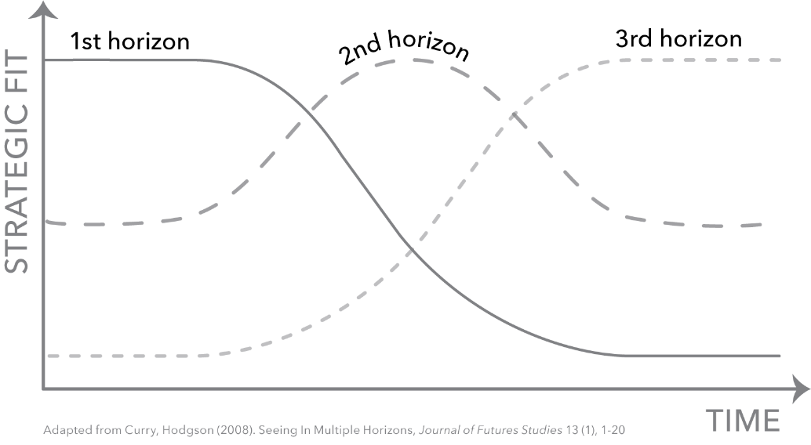
Three Horizons
Current system:
Neoliberal Capitalism
Transition:
Gradual
OR
Collapse
New system:
After Capitalism
Images
2020-2030
2030-2040
2040-2050
Time

Slide 6
Framing: Domain Map
What are potentially compelling images of the next system after capitalism?

Slide 7
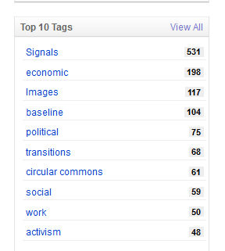
Diigo Scanning Library
696 scan hits

Slide 8
After Capitalism [Book] Concepts
Horizon 3 IMAGES Betterness Circular Commons 1 Commons 2 Degrowth Doughnut Eco Local Post-Growth Sacred/Gift Steady-State Sufficiency Well-Being Alter-Worlds Communism Economic Democracy FALC (Fully Automated Luxury Communism) Pluralist Commonwealth Post-capitalism Precariat* Solidarity* Utopia (for Realists) 23. Abundance 24. Homo Deus 25. Singularity 26. Transhumanism 27. Superintelligence 28. Zero Marginal Cost | Horizon 2 TRANSITIONS 29. Conscious 30. Green 31. Regenerative 32. Satoyama 33. Sustainability 34. Collaborative 35. 4th Industrial Revolution 36. Gig 37. Hybrid 38. P2P 39. Platform 40. Second 41. Second Machine Age 42. Sharing 43. Algorithm/Data 44. Artisan 45. Attention 46. Experience 47. Intangible 48. Leisure 49. Network 50. Philanthro-capitalism 51. Purpose 52. Relationship

Slide 9
Image Analysis Template
Image analysis template
Category | Description
Author | Who proposed it and why (purpose)
Time horizon | Stated, implied, or unclear
Scope: | Global/regional/national or affluent/emerging/poor
Key drivers | Bold relevant Shifting values, Technology acceleration, Inequality, Automation, Stagnation, Climate and carrying capacity, Ineffective left | Other
Key ideas | The most important ideas put forth by the concept
Ideal or guiding values | Something akin to an organizing principle/motivation, i.e., create a more just or fair society
Emotional, aesthetic, and spiritual aspects | Is it appealing or compelling?
Personal | How are individuals affected by this future? Who's bearing the most costs, who's accruing the benefits?
Pathway or plan | Rough sense of steps for achieving

Slide 10
Key Drivers of Change
The Drivers
Shifting values
Technology acceleration
Inequality
Automation
Stagnation
Climate and carrying capacity
Ineffective left
A driver is a thematic cluster of related research inputs that is driving or shaping change.

Slide 11
1. Shifting Values
1. Shifting Values
Values are shifting from traditional and modern to postmodern and integral.
Shades of green – Circular Economy Project

Slide 12
2. Technology Acceleration
Technological capabilities continue to increase rapidly, often exponentially, in a wide range of sectors.

Slide 13
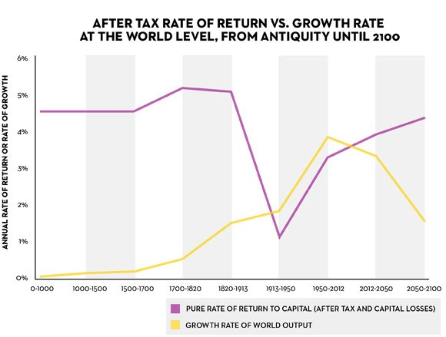
3. Inequality
Growing economic inequality is threatening the social order.
Return on capital investments (Picketty puts at 5%) beats economic growth (puts at 1-2%). This creates an advantage for previously accumulated wealth that exacerbates in equality.
Suggestion: A progressive global tax on capital as a redistributive mechanism coupled with a very high level of financial transparency, which he admits is a utopian idea.
https://www.newyorker.com/news/john-cassidy/pikettys-inequality-story-in-six-charts

Slide 14
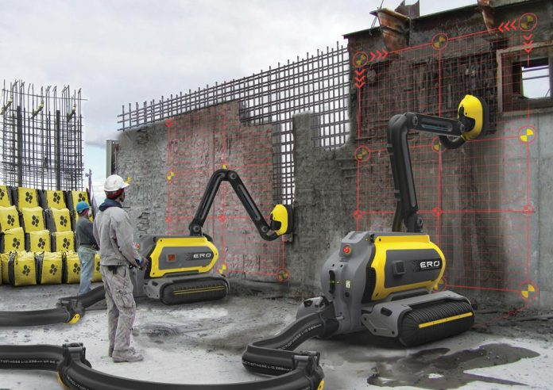
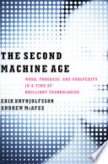
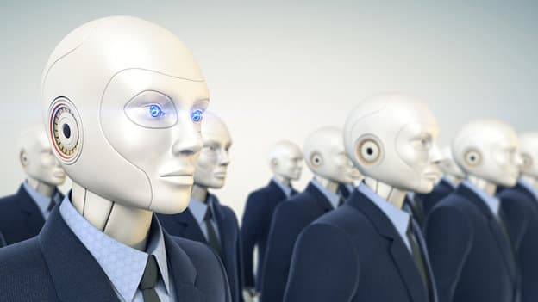
4. Automation & Labor
Automation, driven by AI, is increasingly replacing jobs.
Creates more jobs than it destroys
Automation and other forms of technological progress in aggregate create more jobs than they destroy
Destroys more jobs than it creates
Thorny challenges: Technological progress is going to leave behind some people, perhaps even a lot of people

Slide 15
5. Stagnation
Economic growth is slowing in part due to inability to pay.
Growth Imperative
Enclosure
Financial Economy
Commodification
Alternatives
Eventually there aren’t enough paying customers to subsidize the free information.

Slide 16
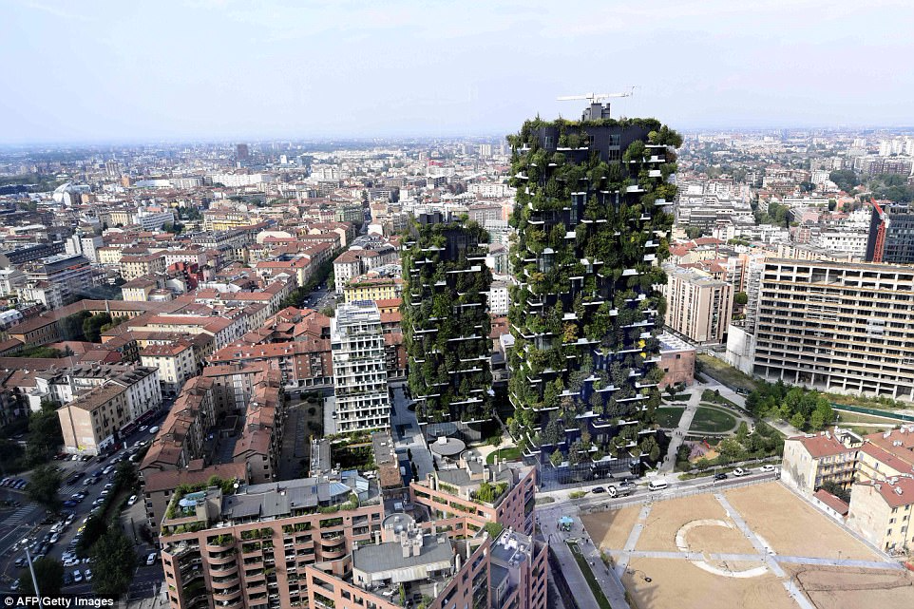
6. Climate & Carrying Capacity
Climate change and humanity’s growing ecological footprint are threatening the ecosystem.
Net Plus (Italy)

Slide 17
7. Ineffective Left
The far left continues to be ineffective in catalyzing change
Reds
Industrials
Techs
Blues
?

Slide 18
KEY ASSUMPTION Neoliberal Capitalism is (Slowly) Disintegrating
Structure produces levels of inequality that is no longer acceptable
Growth imperative threatens ecosystem
Modern values perfectly suited to capitalism no longer fit
Scarcity no longer fits with reality of growing abundance
Recent “explosion” of reform and alternatives concepts
GDP as success no longer works

Slide 19
The Images of After Capitalism

Slide 20
Horizons and Scenario “Archetypes” (i.e., patterns of change)
H3
H1
H2
Current way of doing things within the domain
Zone of transition
Vision of New system
NEW EQUILIBRIUM > Changing Rules
The system reaches a balance among competing forces that is significantly different from the current balance.
TRANSFORMATION > New Rules
The system is discarded in favor of a new one with a new set of rules..
BASELINE >
Same Rules
The system moves forward along its current trajectory. This is the “official future” and usually considered most likely.
COLLAPSE > No Rules
The system falls apart under the weight of “negative” forces.

Slide 21
After Capitalism Scenarios
H1
H2
H3
Transformation
New equilibrium
Circular Commons
Sustainability Transition
Collaborative Sharing Platforms
New Sources of Value
Baseline
Neoliberal Capitalism
Overshoot
Non-Worker’s Paradise
Class War
Rogue AI
Collapse
Tech-Led Abundance

Slide 22
Key Result
Three Images of After Capitalism

Slide 23
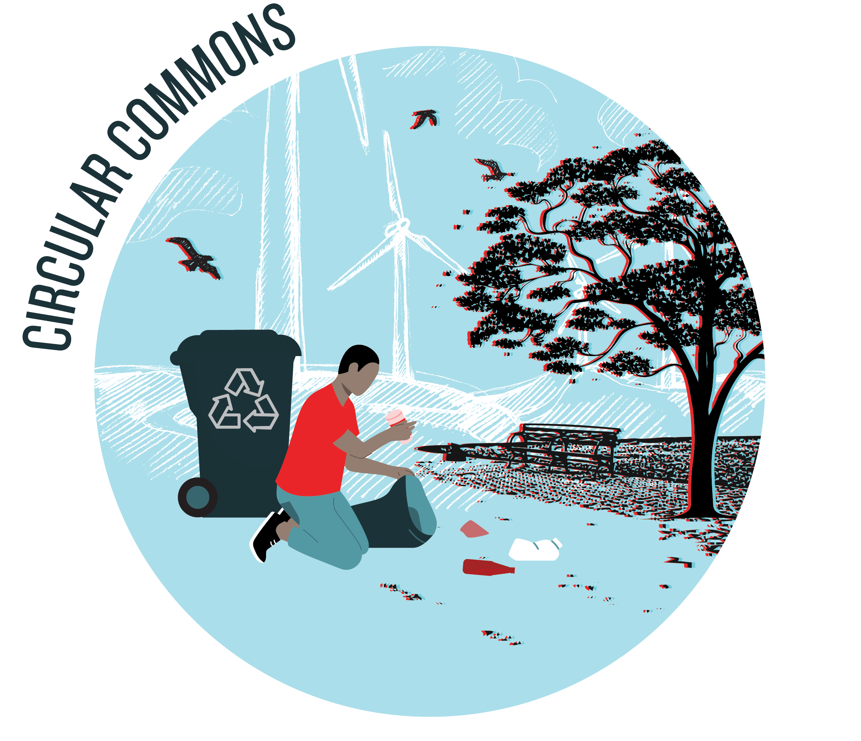
Circular Commons
Expands the concept of sustainability to embrace circular principles as part of a social, political, and economic commons.
Climate and carrying capacity
From sustainable to circular
Commons approach to resource management
Degrowth
Reintegrating with nature
Grassroots & local
Gift economy
New measures of success
KEY CONCEPTS
Betterness, Umair Haque
Circular, Macarthur Foundation
Commons 1, David Bollier
Commons 2, Massimo de Angelis
Degrowth, Giorgos Kallis et al
Doughnut, Kate Raworth
Eco, Otto Scharmer
Local, BALLE
Post-Growth, Tim Jackson
Sacred/Gift, Charles Eisenstein
Steady-State, CASSE/Herman Daly
Sufficiency, Sam Alexander
Well-Being, Lorenzo Fioramont
Purpose environmental stewardship for saving humanity from potential ecosystem collapse

Slide 24
Non-Workers Paradise
A play on the attributed-to-Marxist idea of a worker’s paradise, but in the After Capitalism world we are not working in paid jobs as a means of sustenance.
Society over economy
Inequality reduced via redistribution
UBI
Confronting laziness lie
Left gets it together
Tech acceleration as enabler
Organizing: Local and Direct [Democracy]
Key Sources
Alter-Worlds, Shaw and Waterstone
Communism, Peter Frase
Economic Democracy, David Schweickart
Pluralist Commonwealth, Gar Alperovitz
Post-capitalism, Paul Mason/Srnicek and Williams
Precariat, Guy Standing
Solidarity, Solidarity Economy Initiative
FALC Fully Automated Luxury Communism, Aaron Bastani
Utopia for Realists, Rutger Bregman.
Purpose reducing inequality to creating a more just and fair society.

Slide 25
Tech-Led Abundance
Technological progress drives and leads to an abundance of wealth that fixes core distribution problem of capitalism. Goods and services, once reserved for the wealthy few, now available to ALL who need them
Sharp focus on tech
Bounty, e.g., solar
Enables automation; distribution figured out
People and machines: augmentation and transhumanists
Scarcity to abundance
Most risky, geoengineering & species
Zero marginal cost
incentivizing entrepreneurs
Abundance, Peter Diamandis
Homo Deus, Yuval Harari
Singularity, Ray Kurzweil
Transhumanism, Max More
Super-intelligence, Nick Bostrom
Zero Marginal Cost, Jeremy Rifkin
Purpose to create an abundance that solves the world’s problems via technology.

Slide 26
Poll: Potential Issues for GM

Slide 27
Poll Questions
Question: Which three issues should GM start working on NOW?
If or when should we move to a circular approach?
Are we prepared to support degrowth approach to our shareholders/stakeholders?
Is there a role for us in a commons or gift economy?
How might we reframe measures of success?
How might we reduce inequality in our organization and make our products/services more affordable to all?
How would we attract people to work for us if a UBI is implemented?
How might we move to a direct democratic approach?
If or how concerned are we about increasing reliance on technology, i.e., AI and automation?
How might we incentive innovation without a capitalist reward structure, e.g., IP protection?

Slide 28
Circular Commons
Expands the concept of sustainability to embrace circular principles as part of a social, political, and economic commons.
Top issues
If or when should we move to a circular approach?
Are we prepared to support degrowth approach to our shareholders/stakeholders?
Is there a role for us in a commons or gift economy?
How might we reframe measures of success?

Slide 29
Non-Workers Paradise
A play on the attributed-to-Marxist idea of a worker’s paradise, but in the After Capitalism world we are not working in paid jobs as a means of sustenance.
Top Issues
How might we reduce inequality in our organization and make our products/services more affordable to all?
How would we attract people to work for us if a UBI is implemented?
How might we move to a direct democratic approach?

Slide 30
Tech-Led Abundance
Technological progress drives and leads to an abundance of wealth that fixes core distribution problem of capitalism. Goods and services, once reserved for the wealthy few, now available to ALL who need them
Top issues
If or how concerned are we about increasing reliance on technology, i.e., AI and automation?
How might we incentive innovation without a capitalist reward structure, e.g., IP protection?

Slide 31
Where to Focus

Slide 32
Places to Intervene in a System

Slide 33
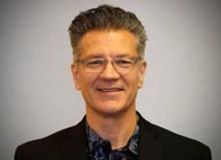
Contact Info
Dr. Andy Hines
Principal, Hinesight &
Program Coordinator
University of Houston
Foresight Program
ahines@uh.edu
832 367 5575
www.andyhinesight.com

Slide 34
IMAGINING AFTER CAPITALISM: TEN MINDSET SHIFTS
FROM | TO
ONE-RIGHT-WAY (traditional, modern, and postmodern) VALUES Or FIRST TIER VALUES | MULTIPLE WAYS (integral) SECOND TIER VALUES
2. ECONOMY | SOCIETY
3. SCARCITY | ABUNDANCE
4. MASTERS (of nature) | PARTNERS (with nature)
5. GROWTH | DEGROWTH
6. USED FUTURES (socialism and communism) | NEW FUTURES (Circular Commons, Non-Workers Paradise, and Tech-Led Abundance)
7. FULL EMPLOYMENT | FULL UNEMPLOYMENT
8. PRIVATE PROPERTY | COMMONS
9. GLOBAL AND LOCAL | LOCAL AND GLOBAL
10. ACCUMULATION | DISTRIBUTION

