Slide 1

Imagining After Capitalism
NEXT Innovation Scholars Program
U of Cincinnati
April 30, 2026

Slide 2
Where Are We Going?

Slide 3


The Image of the Future
“There has been a massive loss of capacity, or even will, for renewal of images of the future.”
The rise and fall of images of the future precedes or accompanies the rise and fall of cultures, e.g., Christianity, the Enlightenment, the Renaissance, the first Industrial Revolution.
The force that drives the image of the future is only in part rational and intellectual; a much larger part is emotional, aesthetic, and spiritual. The appeal of the image lies in its picture of a radically different world in an Other time.
“If you don’t know where you’re going, you might end up somewhere else.”
Notes:
Polak identified it 50+ years ago
UH looked at in 2012
So what do you think, here, today?

Slide 4
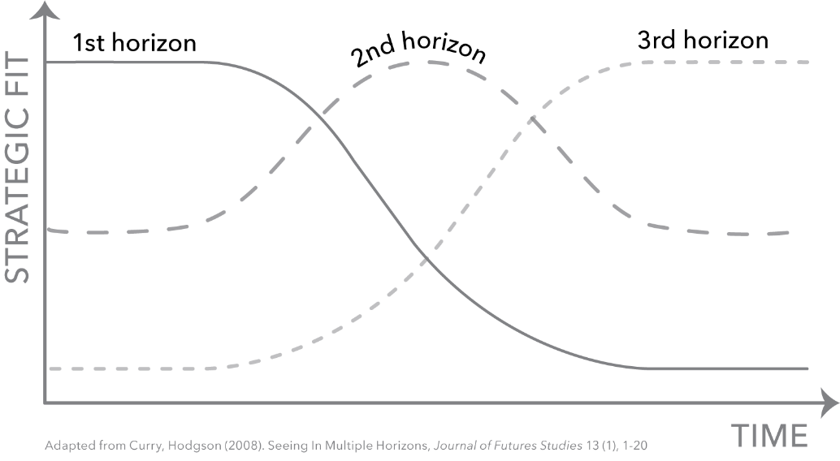
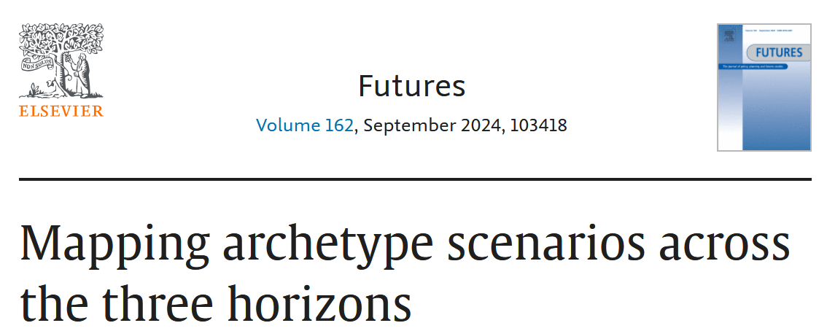
Three Horizons
Current system:
Neoliberal Capitalism
Transition:
Looping
OR
Collapse
New system:
After Capitalism
Images
The dominant transition pattern
was ????
2020-2030
2030-2040
2040-2050
LOOPING
Time

Slide 5

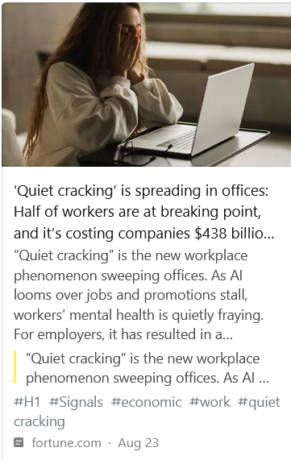
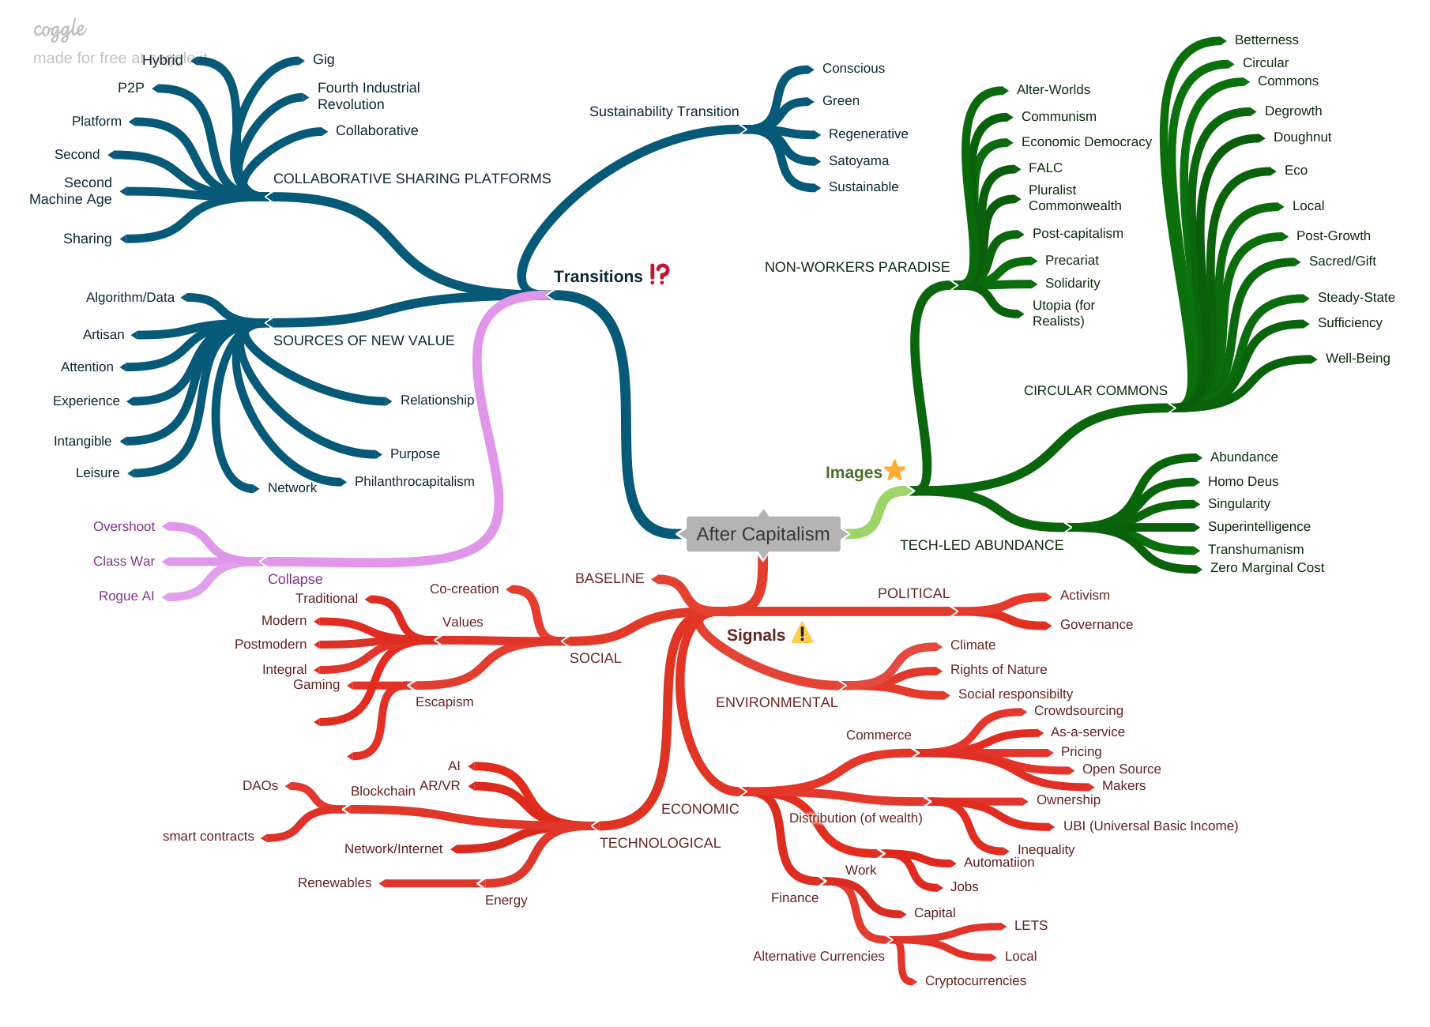
Scanning Library
Domain Map
Over 1,000 scan hits

Slide 6
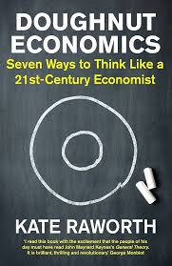
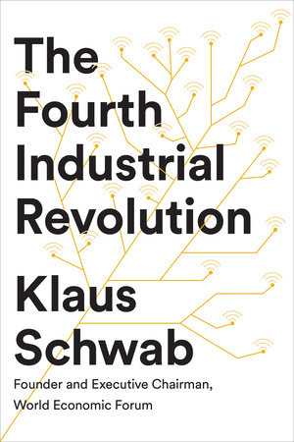
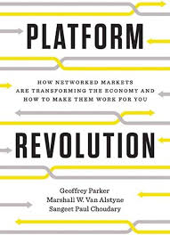
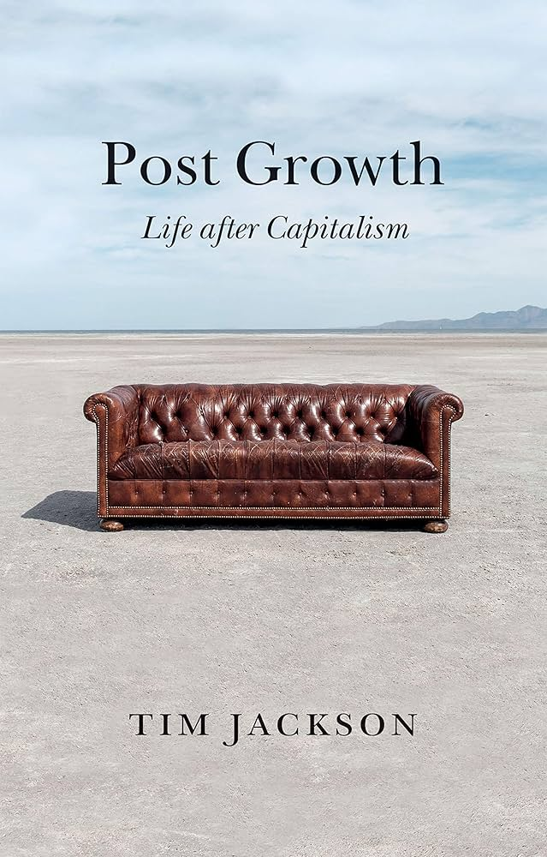
After Capitalism [Book] Concepts
Horizon 3 IMAGES Betterness Circular Commons 1 Commons 2 Degrowth Doughnut Eco Local Post-Growth Sacred/Gift Steady-State Sufficiency Well-Being Alter-Worlds Communism Economic Democracy FALC (Fully Automated Luxury Communism) Pluralist Commonwealth Post-capitalism Precariat* Solidarity* Utopia (for Realists) 23. Abundance 24. Homo Deus 25. Singularity 26. Transhumanism 27. Superintelligence 28. Zero Marginal Cost | Horizon 2 TRANSITIONS 29. Conscious 30. Green 31. Regenerative 32. Satoyama 33. Sustainability 34. Collaborative 35. 4th Industrial Revolution 36. Gig 37. Hybrid 38. P2P 39. Platform 40. Second 41. Second Machine Age 42. Sharing 43. Algorithm/Data 44. Artisan 45. Attention 46. Experience 47. Intangible 48. Leisure 49. Network 50. Philanthro-capitalism 51. Purpose 52. Relationship

Slide 7
Image Analysis Template
Image analysis template
Category | Description
Author | Who proposed it and why (purpose)
Time horizon | Stated, implied, or unclear
Scope: | Global/regional/national or affluent/emerging/poor
Key drivers: | Bold relevant Shifting values, Technology acceleration, Inequality, Automation, Stagnation, Climate and carrying capacity, Ineffective left | Other
Key ideas | The most important ideas put forth by the concept
Ideal or guiding values | Something akin to an organizing principle/motivation, i.e., create a more just or fair society
Emotional, aesthetic, and spiritual aspects | Is it appealing or compelling?
Personal | How are individuals affected by this future? Who's bearing the most costs, who's accruing the benefits?
Pathway or plan | Rough sense of steps for achieving

Slide 8
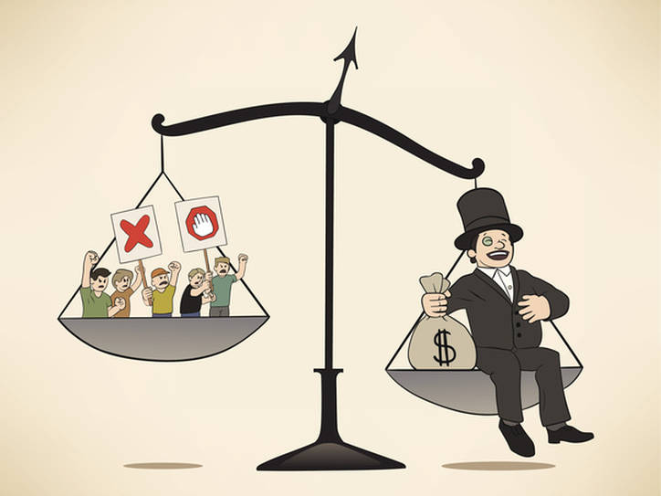

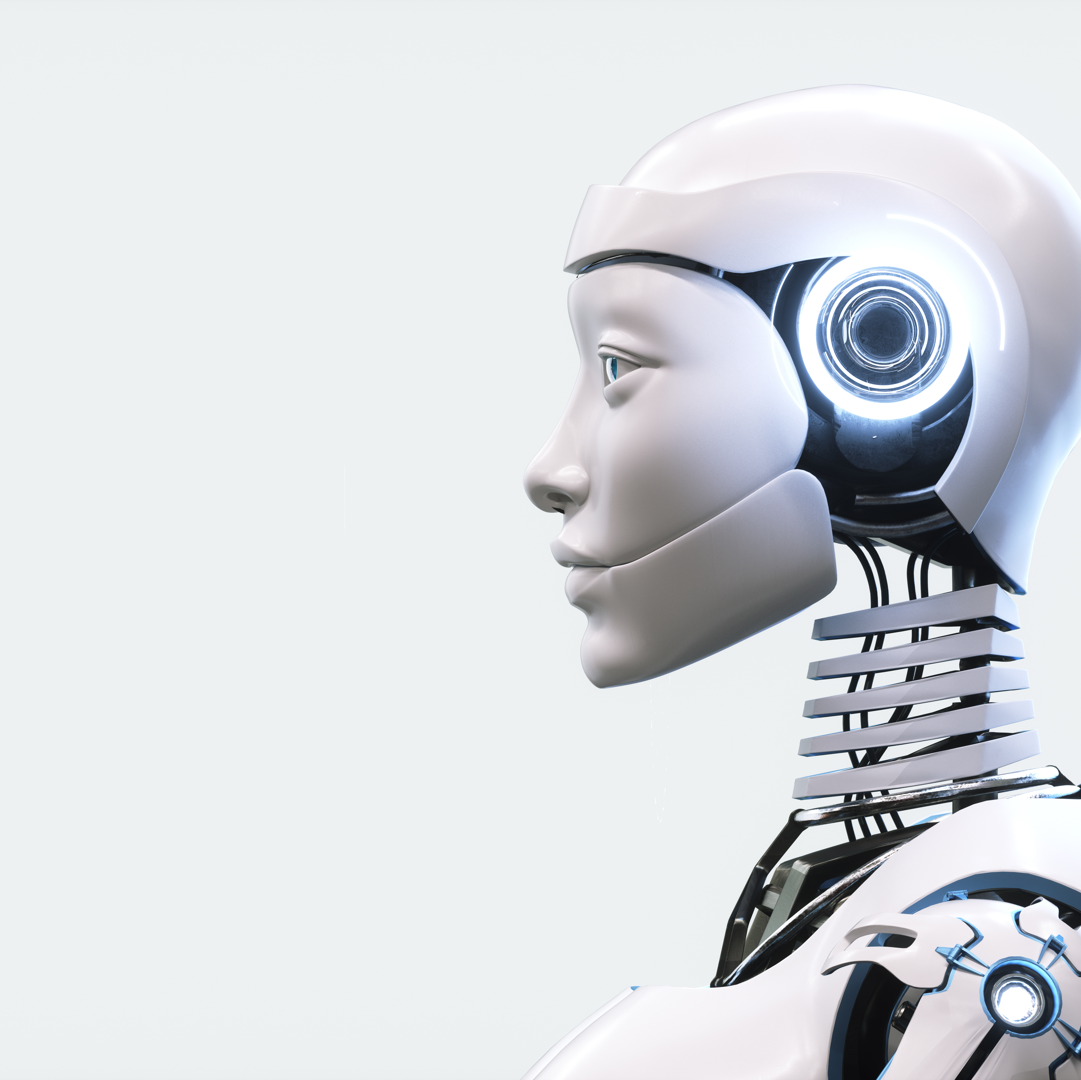

A system’s behavior is a function of its structure. Every system is perfectly designed to get the results it gets.
Neoliberal Capitalism produces . . .
Inequality
Growth
Accelerating Technology
Overshoot
Notes:
[REQUIRED]
A system's behavior is a result of its structure, such as how a city's rules and regulations influence building and living.
Our system of politics
Systems maps help visualize these relationships
Rush hour, a product of business hours, is an example where the system produces undesirable outcomes, like traffic congestion.

Slide 9
The Core Problem: We Live in an Economy, Not a Society!
Why are we doing capitalism?
Inertia, momentum.
More and more people are answering no;
What we should we be doing instead?
This is what Imagining After Capitalism is all about.
Perhaps an equal amount are simply giving up on the future.
Despite its faults, it has been a successful system in delivered on economic growth and wealth creation [for some].
Is capitalism what we want to do?

Slide 10
Key Drivers of Change
The Drivers
Shifting values
Technology acceleration
Inequality
Automation
Stagnation
Climate and carrying capacity [from Growth]
Ineffective left
A driver is a thematic cluster of related research inputs that is driving or shaping change.

Slide 11
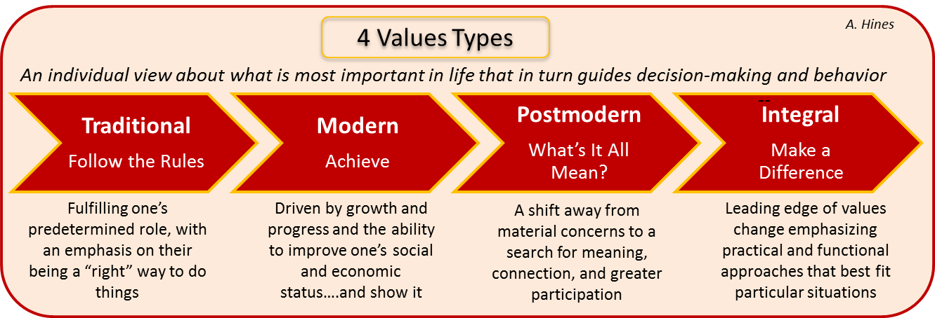
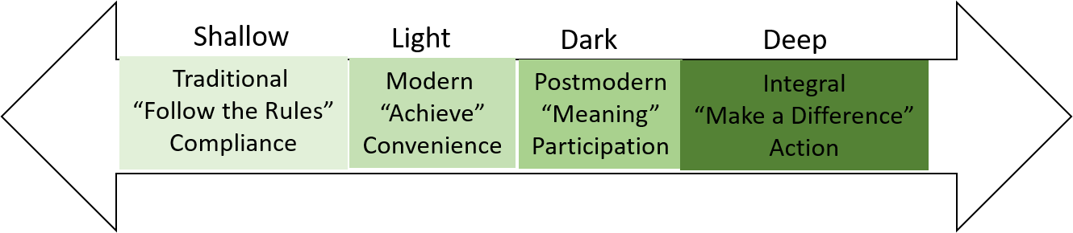
1. Shifting Values
Values are shifting from traditional and modern to postmodern and integral.
Shades of green – Circular Economy Project

Slide 12

2. Technology Acceleration
Technological capabilities continue to increase rapidly, often exponentially, in a wide range of sectors.

Slide 13
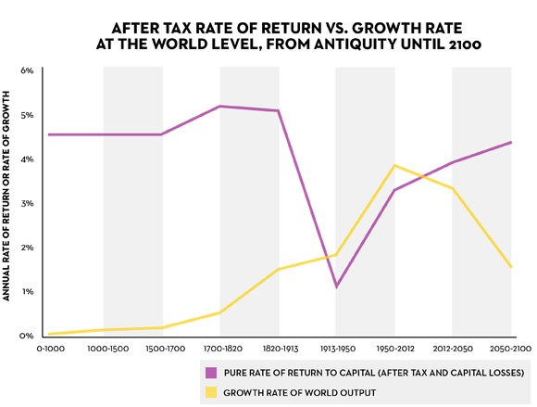
3. Inequality
Growing economic inequality is threatening the social order.
Return on capital investments (Picketty puts at 5%) beats economic growth (puts at 1-2%). This creates an advantage for previously accumulated wealth that exacerbates in equality.
Suggestion: A progressive global tax on capital as a redistributive mechanism coupled with a very high level of financial transparency, which he admits is a utopian idea.
https://www.newyorker.com/news/john-cassidy/pikettys-inequality-story-in-six-charts

Slide 14
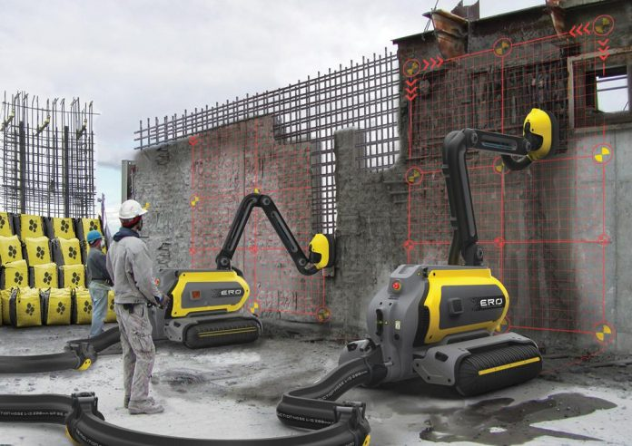
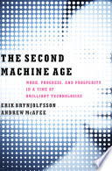
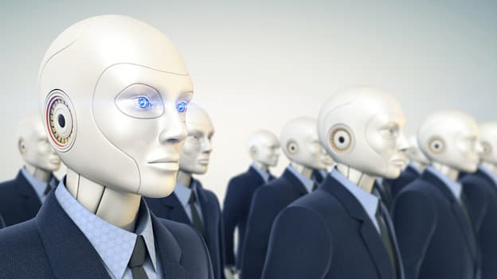
4. Automation & Labor
Automation, driven by AI, is increasingly replacing jobs.
Creates more jobs than it destroys
Automation and other forms of technological progress in aggregate create more jobs than they destroy
Destroys more jobs than it creates
Thorny challenges: Technological progress is going to leave behind some people, perhaps even a lot of people

Slide 15

5. Stagnation
Economic growth is slowing in part due to inability to pay.
Growth Imperative
Enclosure
Financial Economy
Commodification
Alternatives
Eventually there aren’t enough paying customers to subsidize the free information.

Slide 16
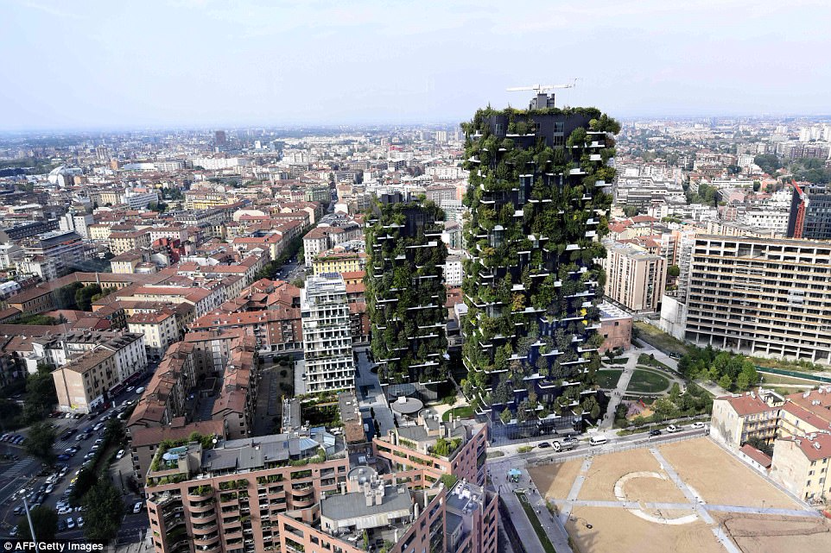
6. Climate & Carrying Capacity
Climate change and humanity’s growing ecological footprint are threatening the ecosystem.
Net Plus (Italy)

Slide 17
7. Ineffective Left
The far left continues to be ineffective in catalyzing change
Reds
Industrials
Techs
Blues
?

Slide 18
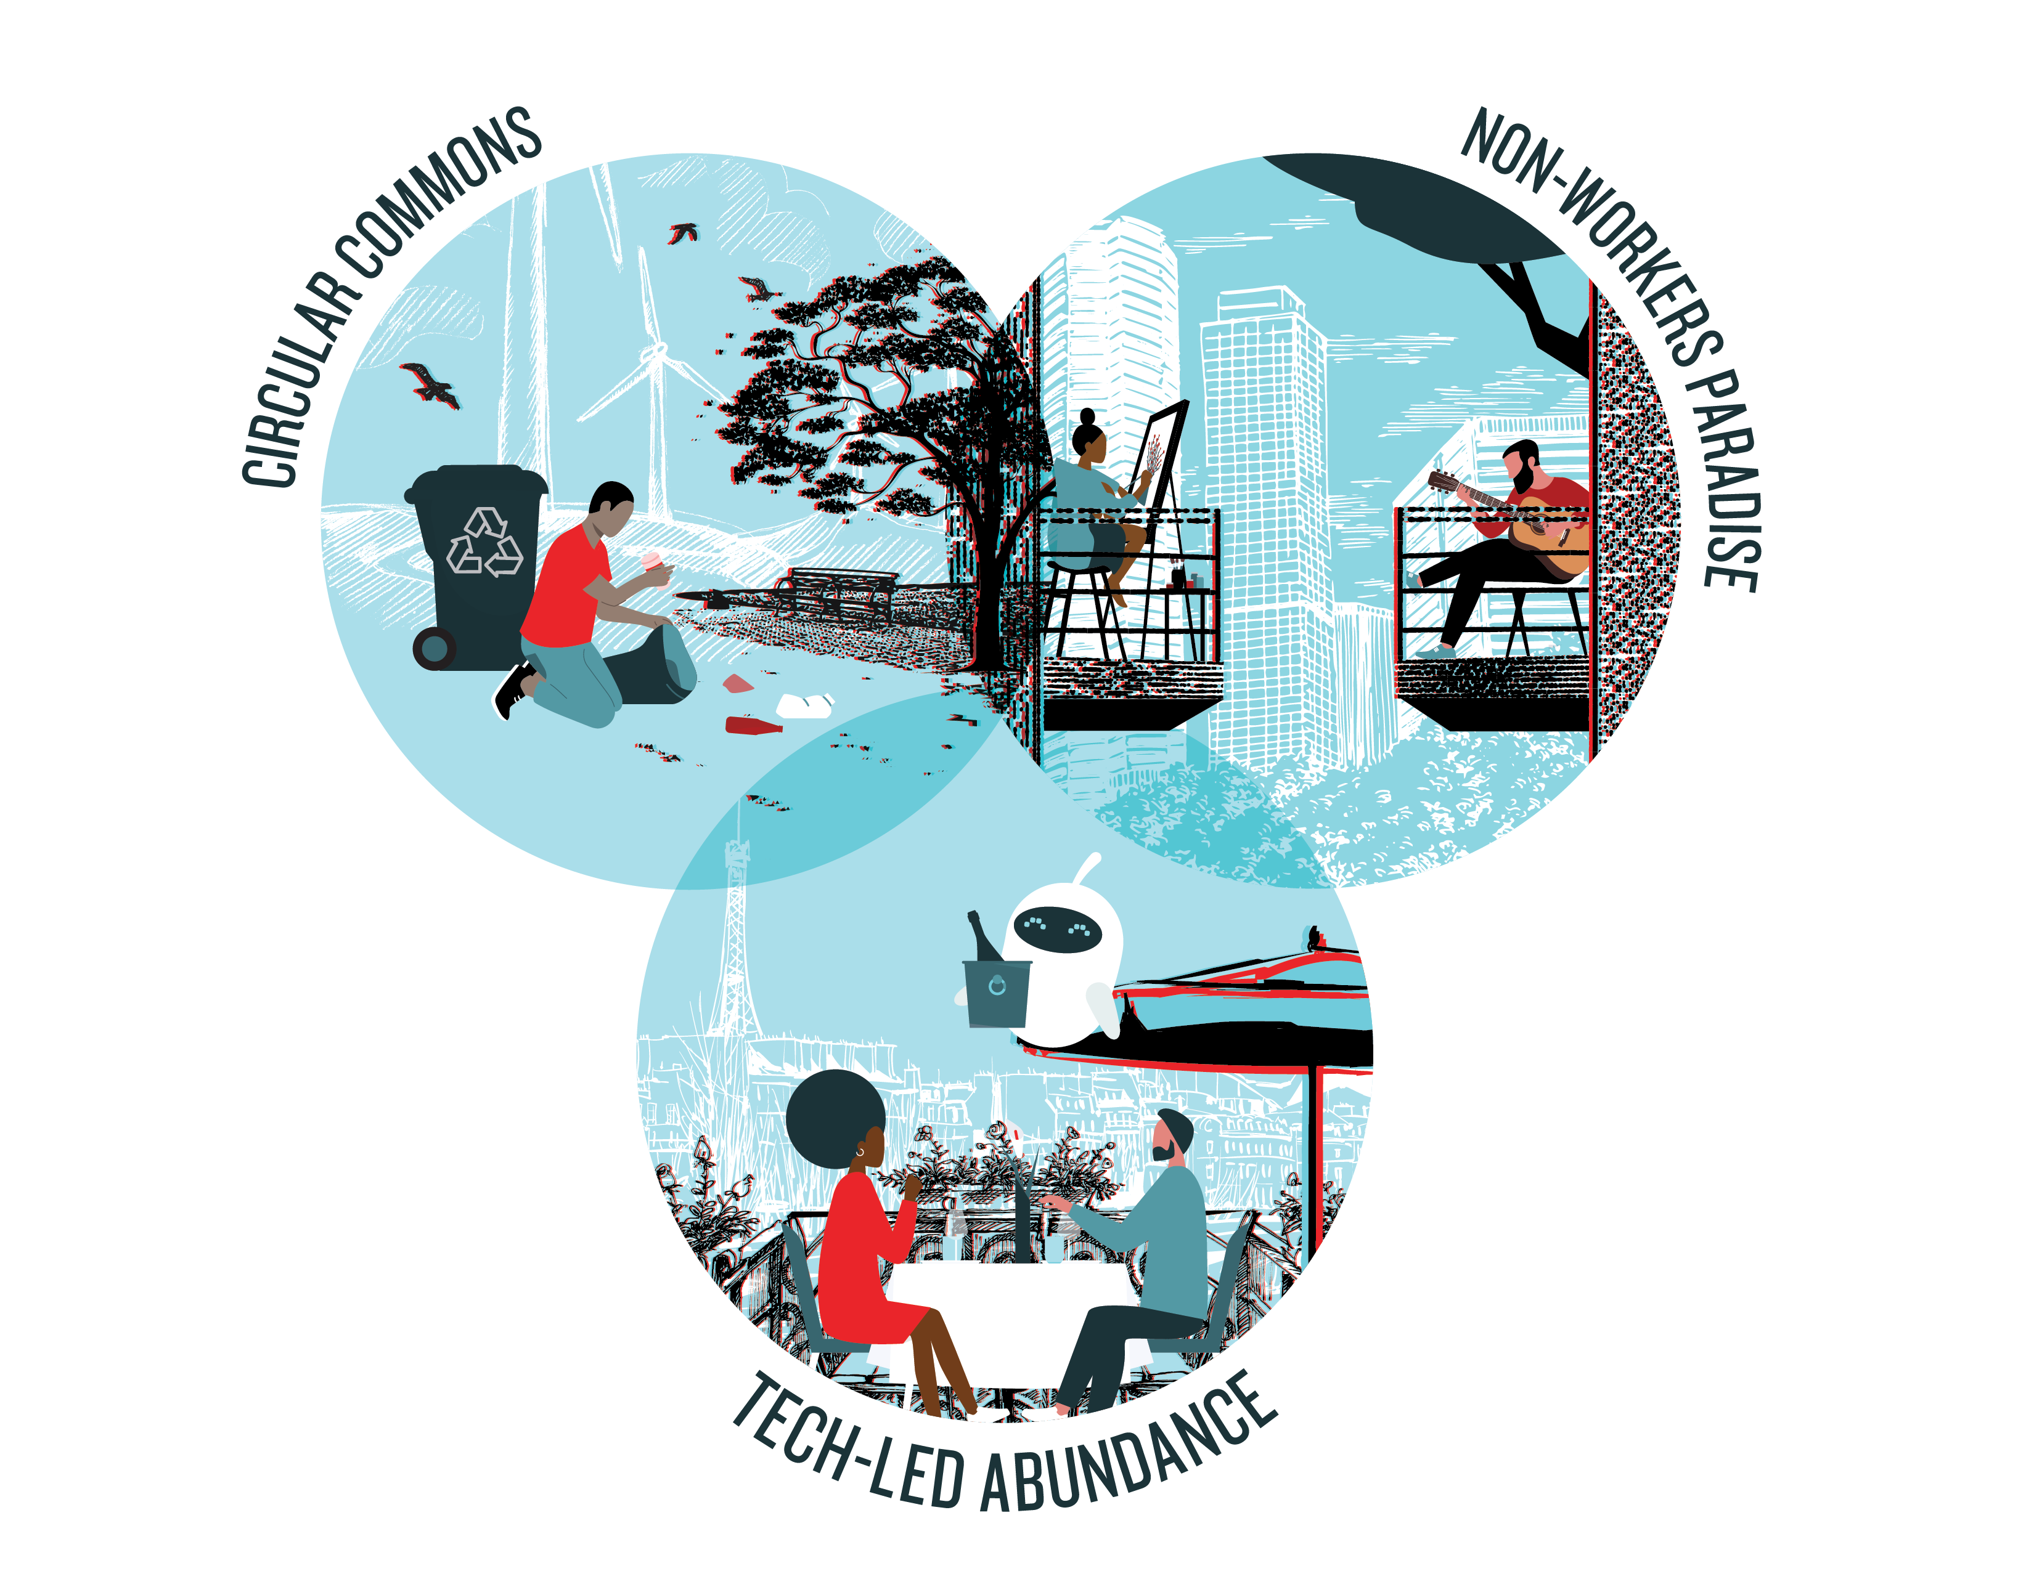
Key Result
Three Images of After Capitalism

Slide 19




The Path
to
After
Capitalism
H1
H2
H3
Transformation
New equilibrium
Circular Commons
Sustainability Transition
Collaborative Sharing Platforms
New Sources of Value
Baseline
Neoliberal Capitalism
Overshoot
Non-Worker’s Paradise
Class War
Rogue AI
Collapse
Tech-Led Abundance

Slide 20
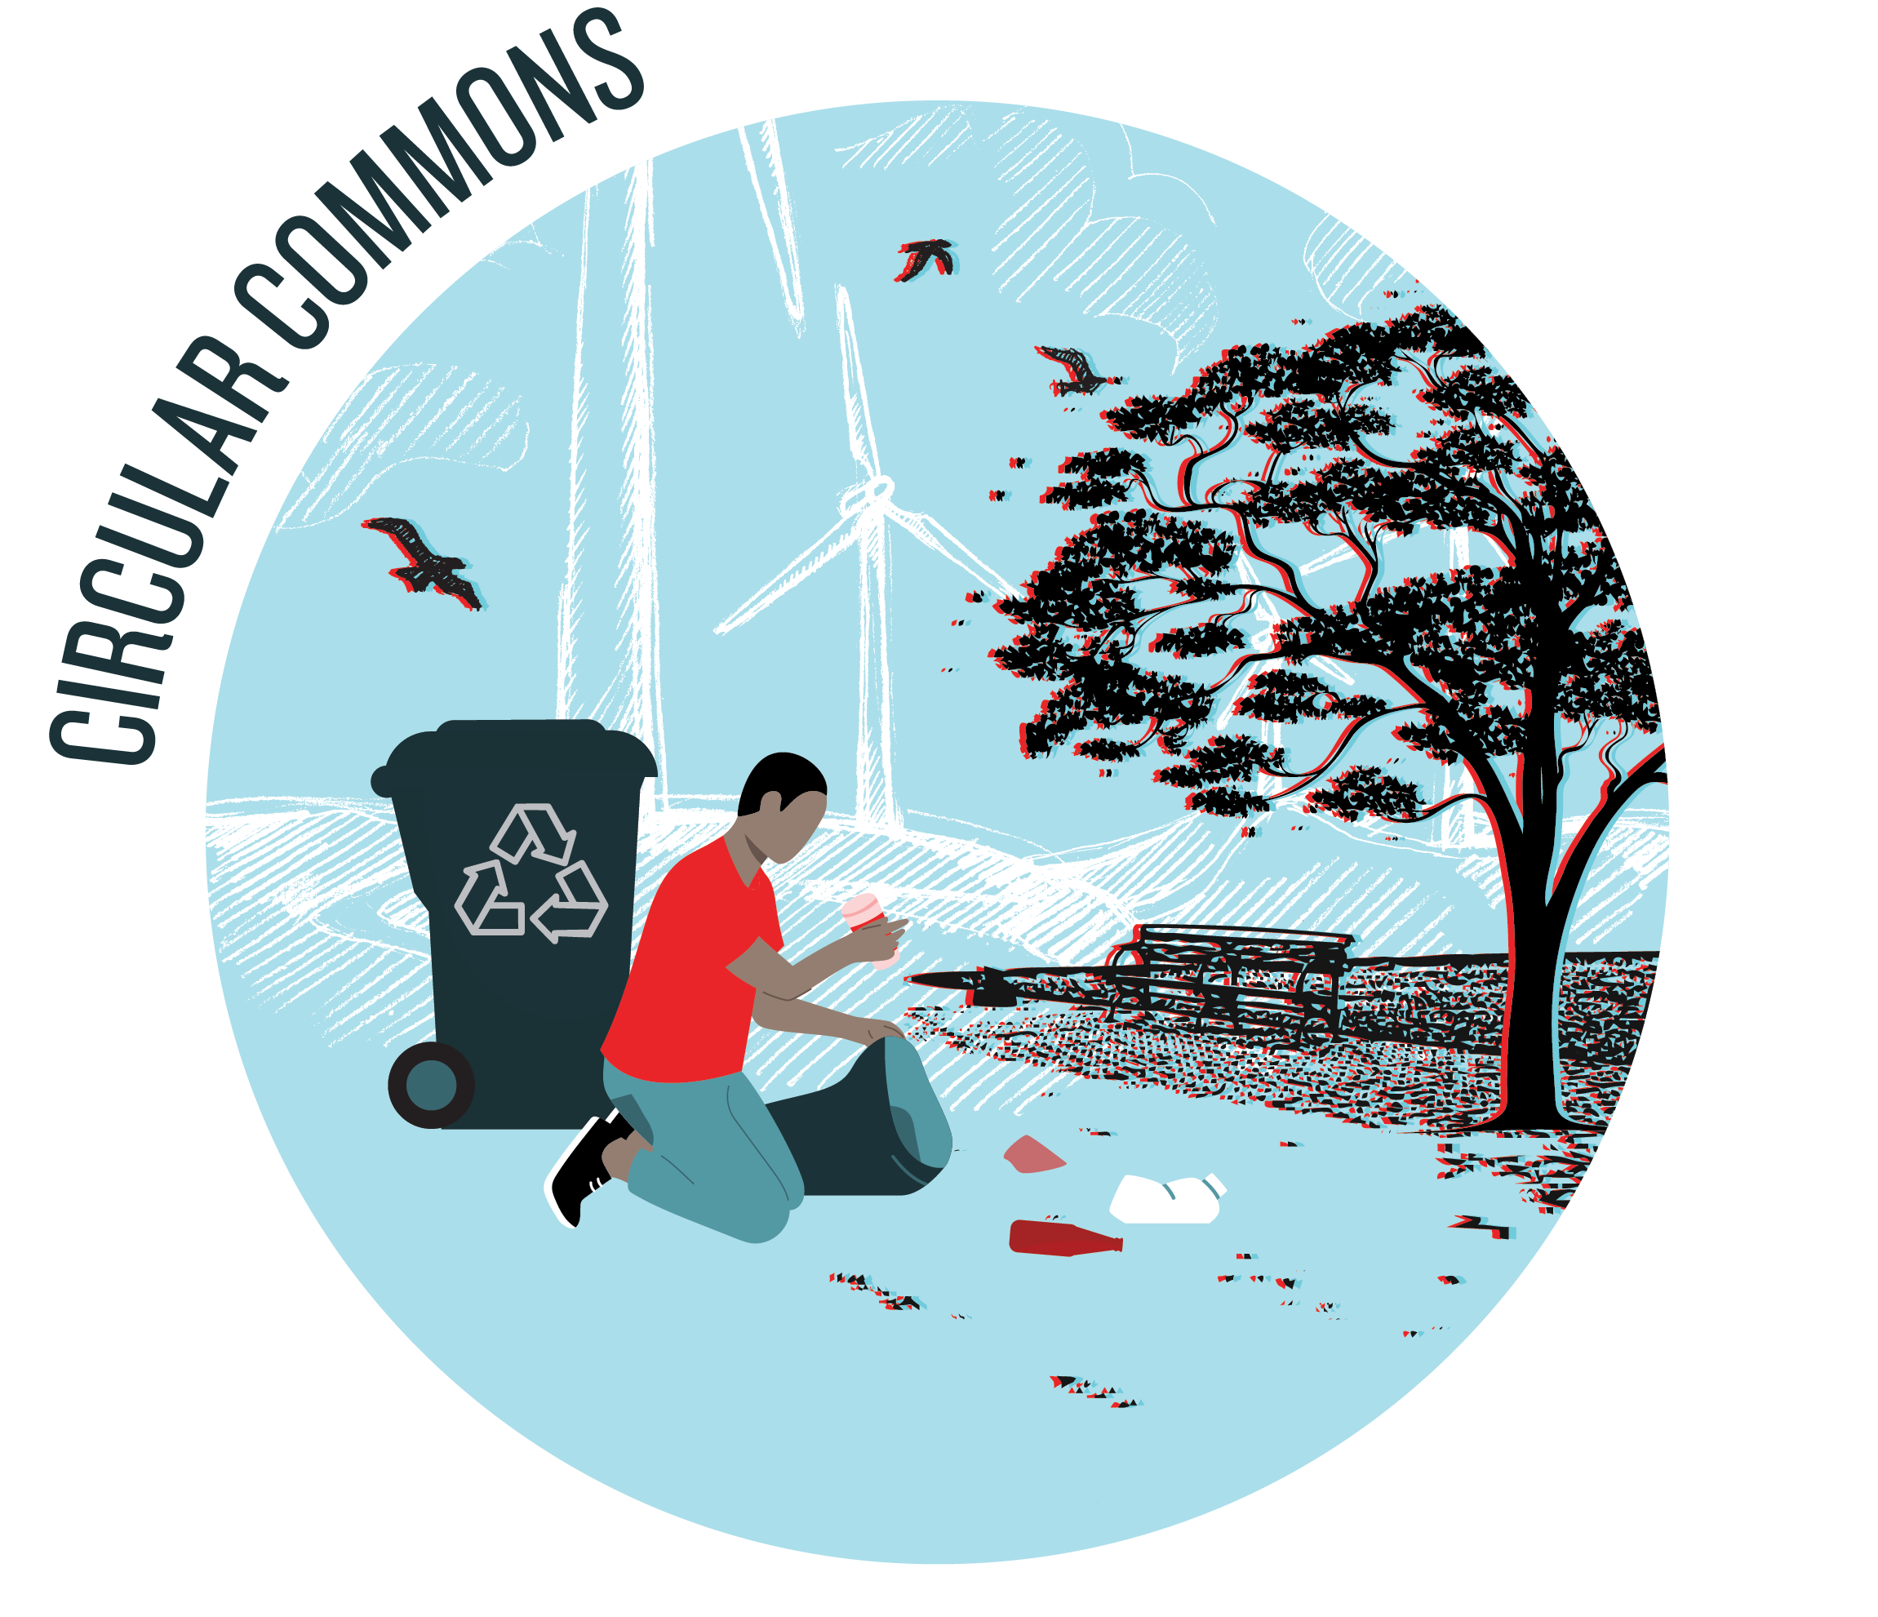
Circular Commons (Environmentally-Driven)
Expands the concept of sustainability to embrace circular principles as part of a social, political, and economic commons.
c
Climate and carrying capacity [Key Driver]
From sustainable to circular
Grassroots & local
Gift economy
New measures of success
BIG 3
Top issues
If or when should we move to a circular approach?
How might we move to a service rather than product approach?
How might we reframe measures of success?
Degrowth
Reintegrating with nature
Commons approach
to resource management
Purpose environmental stewardship for saving humanity from potential ecosystem collapse

Slide 21

He Said “Commons” … is he a commie?
I deliberately steer away from mentioning socialism and communism [Used Futures]
I have no problem with the theory, but with how it’s been applied
BUT keep in mind that there are only so many ways to organize
Individual, e.g., going to sound like capitalism
Collective, e.g. going to sound like communism
Hybrid, e.g., going to sound like socialism
It’s useful to acknowledge that AND add the whole purpose of Imagining After Capitalism was to avoid these used futures and come up with something else!

Slide 22
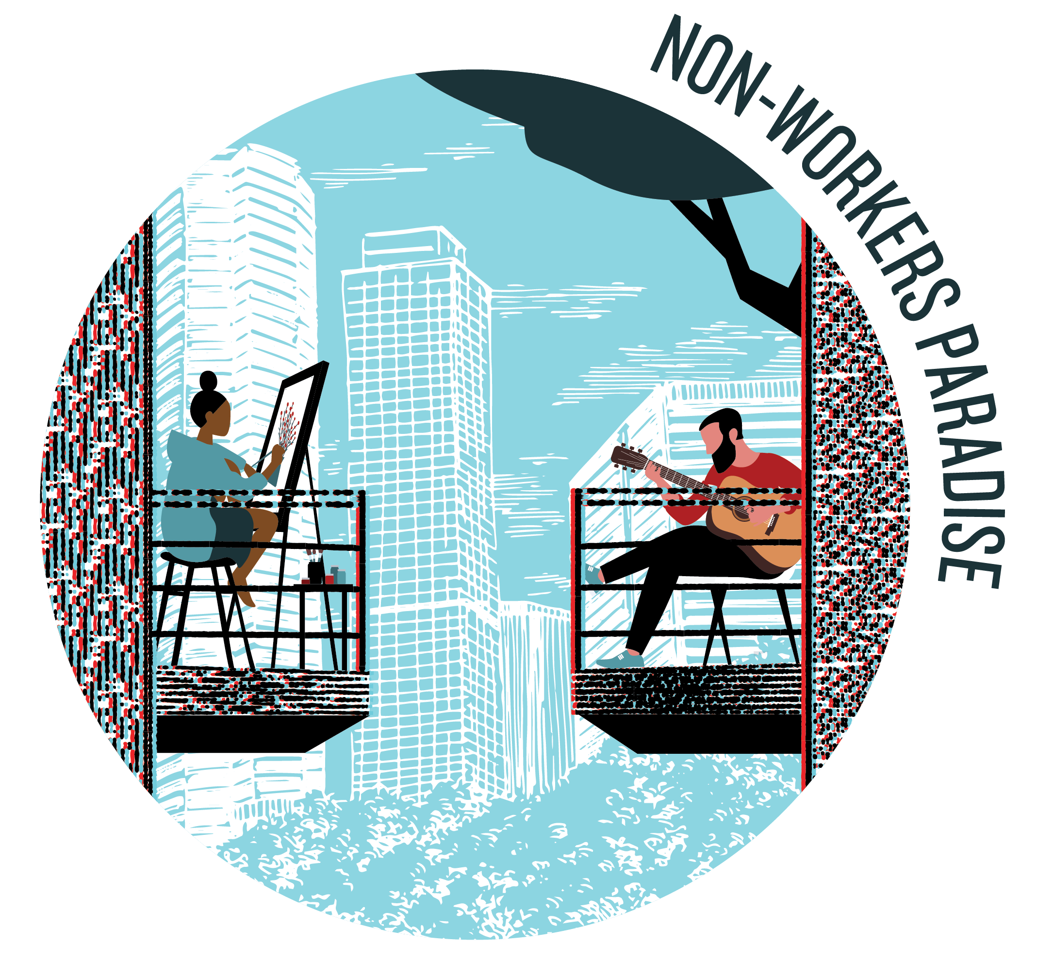
Non-Workers Paradise (Socially-Driven)
A play on the attributed-to-Marxist idea of a worker’s paradise, but in the After Capitalism world we are not working in paid jobs as a means of sustenance.
Key Ideas
Society over economy
Inequality reduced via redistribution
UBI
Left gets it together
Tech acceleration as enabler
c
BIG 3
Top Issues
How might we reduce “inequality” in our portfolio, i.e., more balanced approach less reliant on distinctions between premium and basic?
How might we incentive innovation without a capitalist reward structure, e.g., IP protection?
How might we move to a direct democratic approach in how we operate?
Inequality
Confronting laziness lie
Organizing: Local and Direct Democracy (Purity Tests)
Purpose reducing inequality to creating a more just and fair society.

Slide 23
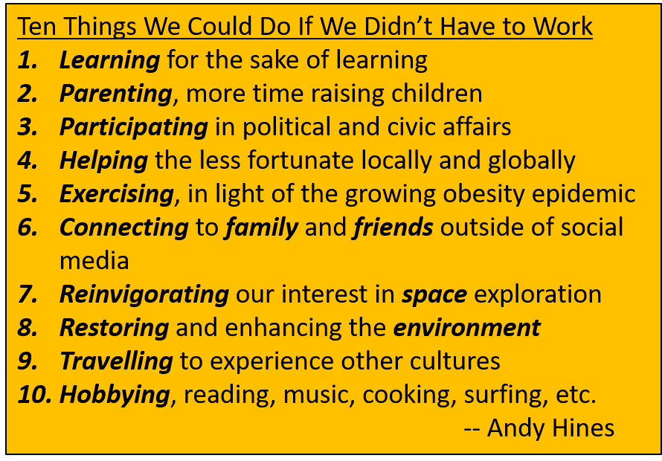
What Will Do If We Don’t a Job? PLENTY!!!!!
Restore and steward the environment
Help poorer nations develop
Participate in the governance of our daily lives
Have Fun!!!!

Slide 24
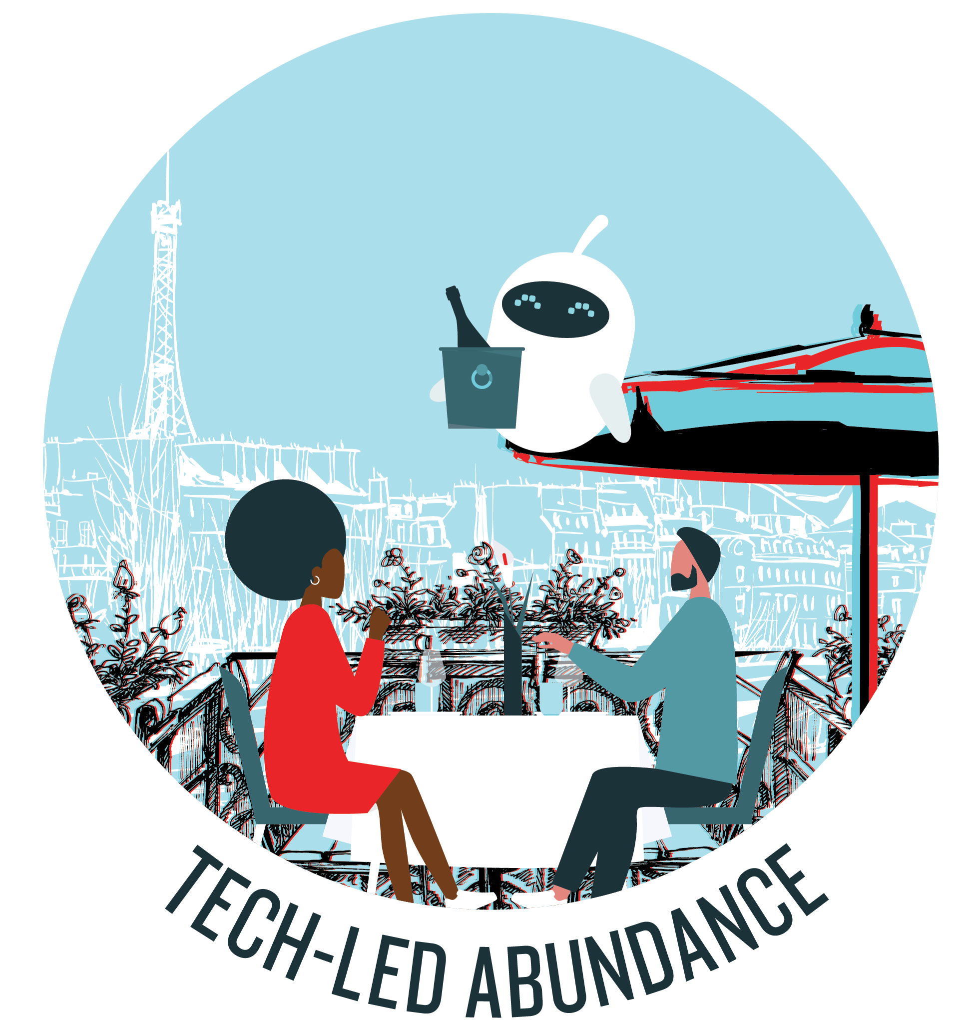
Tech-Led Abundance (Tech-Driven)
Technological progress drives and leads to an abundance of wealth that fixes core distribution problem of capitalism. Goods and services, once reserved for the wealthy few, now available to ALL who need them
Sharp focus on tech
Augmentation & transhumanists
Scarcity to abundance
Most risky, geoengineering & species
Zero marginal cost
incentivizing entrepreneurs
c
BIG 1
Top issues
How do we balance people issues with an increasing reliance on technology, i.e., AI and automation?
What innovation would we prioritize if cost was no longer an object?
How might we redesign the entire system?
Redistribution
Purpose to create an abundance that solves the world’s problems via technology.

Slide 25
[Tech] Change Is Slower Than We Think
1990s
Automated vehicles
3D printing
Prefab housing

Slide 26
What Do We Get … if we make these changes?
Sense of purpose!
Circular Commons
Restoring (not yet restored) ecosystem
A more beautiful place
Healthier people and lifestyles
Non-Workers Paradise
Equity – cooperation over competition
Meaningful activity with collective benefit
Direct participation in how we manage our lives and communities
Tech-Led Abundance
Technology that serves us and the planet, not a few insanely wealth people

Slide 27
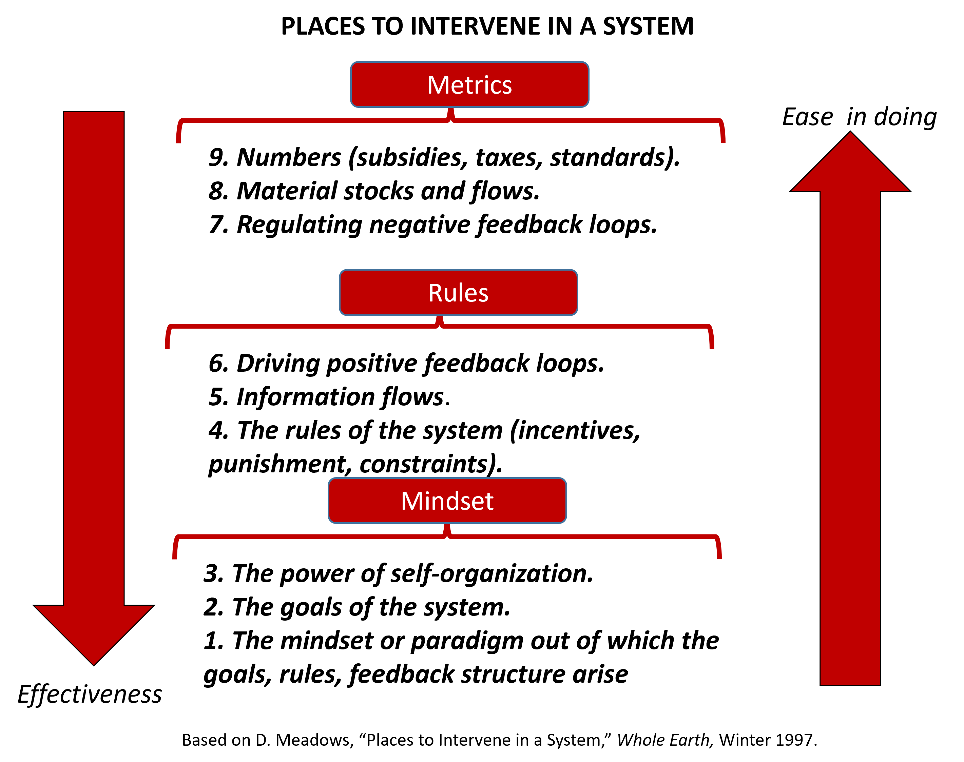
Places to Intervene in a System

Slide 28
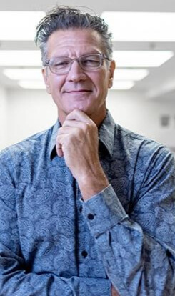
Contact Info
Dr. Andy Hines
Principal, Hinesight &
Program Coordinator
University of Houston
Foresight Program
ahines@uh.edu
www.andyhinesight.com
https://www.imaginingaftercapitalism.com/
https://www.triarchypress.net/after.html

Slide 29
IMAGINING AFTER CAPITALISM: TEN MINDSET SHIFTS
FROM | TO
ONE-RIGHT-WAY (traditional, modern, and postmodern) VALUES Or FIRST TIER VALUES | MULTIPLE WAYS (integral) SECOND TIER VALUES
2. ECONOMY | SOCIETY
3. SCARCITY | ABUNDANCE
4. MASTERS (of nature) | PARTNERS (with nature)
5. GROWTH | DEGROWTH
6. USED FUTURES (socialism and communism) | NEW FUTURES (Circular Commons, Non-Workers Paradise, and Tech-Led Abundance)
7. FULL EMPLOYMENT | FULL UNEMPLOYMENT
8. PRIVATE PROPERTY | COMMONS
9. GLOBAL AND LOCAL | LOCAL AND GLOBAL
10. ACCUMULATION | DISTRIBUTION

Slide 30
Key Drivers of Change
The Drivers
Shifting values
Technology acceleration
Inequality
Automation
Stagnation
Climate and carrying capacity [from Growth]
Ineffective left
A driver is a thematic cluster of related research inputs that is driving or shaping change.
We will be ranking these drivers shortly .. Make some notes!

Slide 31
Your Turn: Circular Commons Key Issues
Instruction to tables: Circle the issue that you feel will be most important to enabling “After Capitalism” and suggest how you might respond to it.
Issues (Circle Top Issue) | Response to Top Issue
If or when should we move to a circular approach?
How might we move to a service rather than product approach?
How might we reframe measures of success?

Slide 32
Your Turn: Non-Workers Paradise Key Issues
Instruction to tables: Circle the issue that you feel will be most important to enabling “After Capitalism” and suggest how you might respond to it.
Issues (Circle Top Issue) | Response to Top Issue
How might we reduce “inequality” in our portfolio, i.e., more balanced approach less reliant on distinctions between premium and basic?
How might we incentive innovation without a capitalist reward structure, e.g., IP protection?
How might we move to a direct democratic approach in how we operate?

Slide 33
Your Turn: Tech-Led Abundance Key Issues
Instruction to tables: Circle the issue that you feel will be most important to enabling “After Capitalism” and suggest how you might respond to it.
Issues (Circle Top Issue) | Response to Top Issue
How do we balance people issues with an increasing reliance on technology, i.e., AI and automation?
What innovation would we prioritize if cost was no longer an object?
How might we redesign the entire system?

